Slide 1

Genre Dynamics and Network Patterns: Unveiling Relationships Between Books’ and Authors’ Networks and Discovering Popularity Trends on Goodreads
Data analytics and visualization
Winter 2024

Slide 2
Methodology
Nodes: Books
Edges: Shared user ratings/reviews
Analysis: Understanding user interests and book trends
Nodes: Users
Edges: Commonly read/reviewed books
Analysis: Building recommendations through shared interests
Nodes: Authors
Edges: Co-authorship links
Analysis: Investigating connections between authors and book similarities
Books network
Users network
Authors network

Slide 3
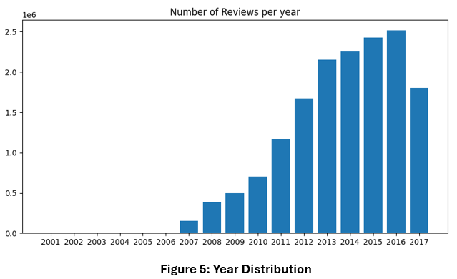
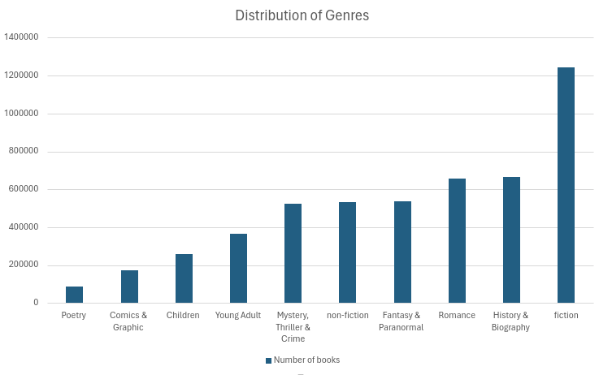
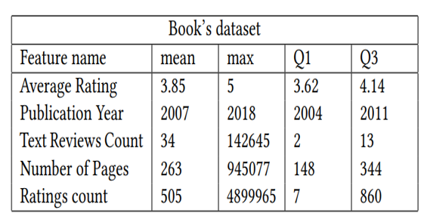
Books Network: Statistical Analysis
Figure 4: Distribution of Genres

Slide 4
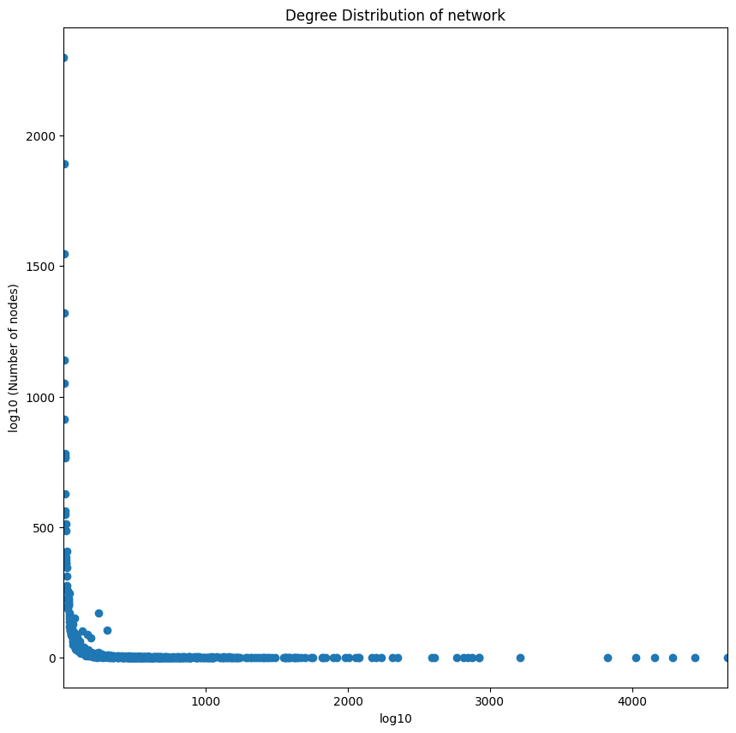
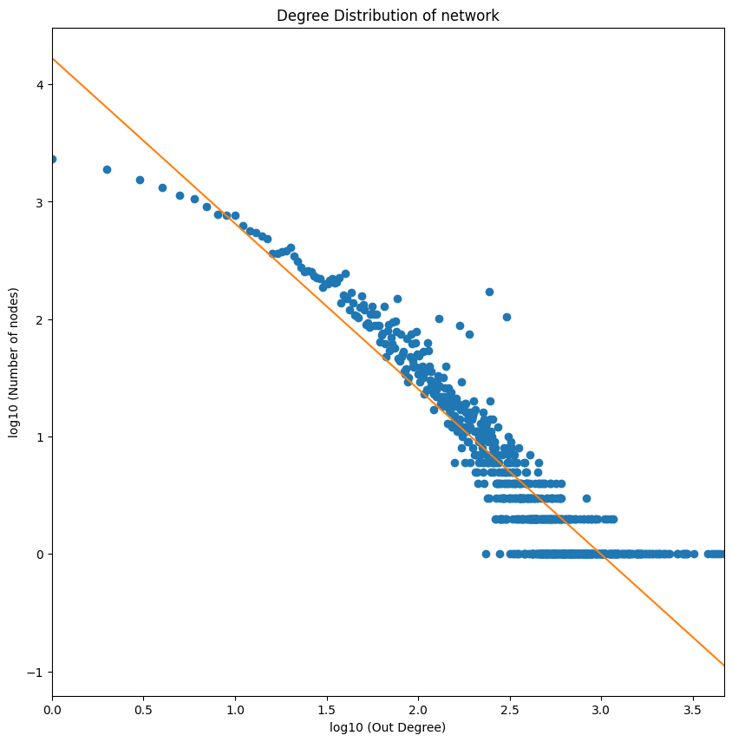
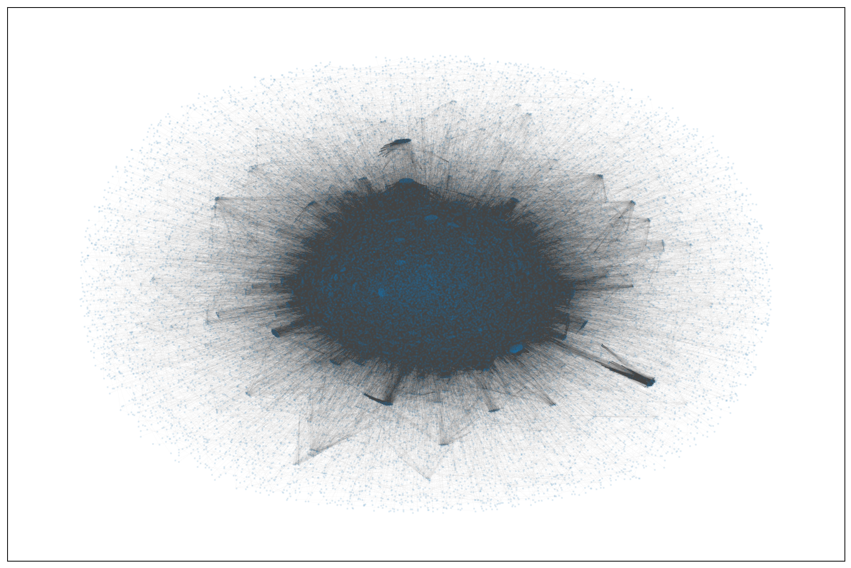
Books Network
Book’s graph visualization
Distribution of edges on book’s graph
Log Distribution of edges on book’s graph
Nodes: 30778
Edges: 856080
Average degree of nodes: 27.8
Average clustering coefficient: 0.70
Erdos-Renyi clustering coefficient:0.0018
Measured alpha of distribution: 1.41

Slide 5

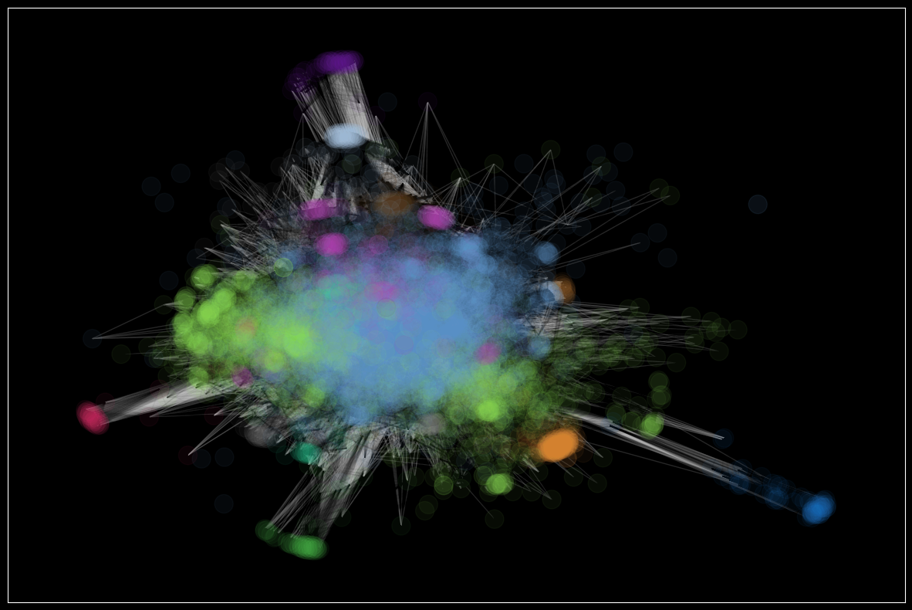
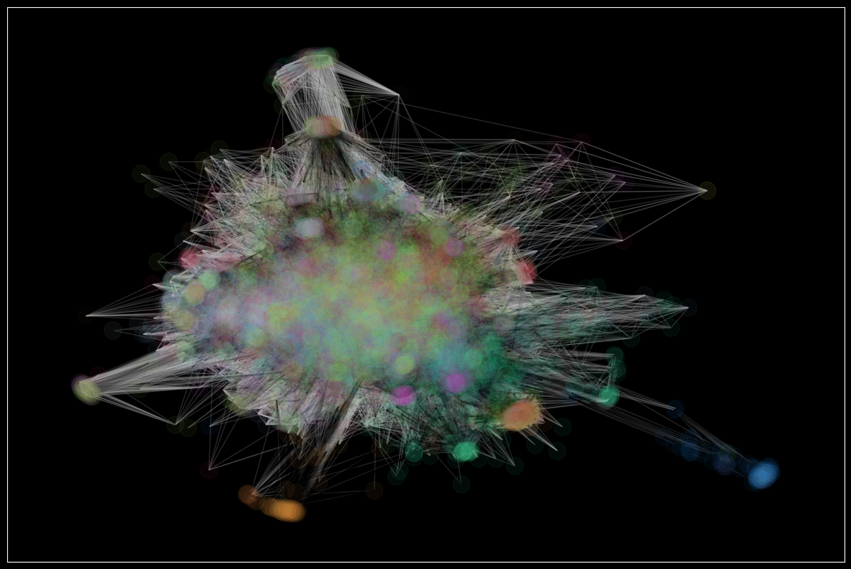
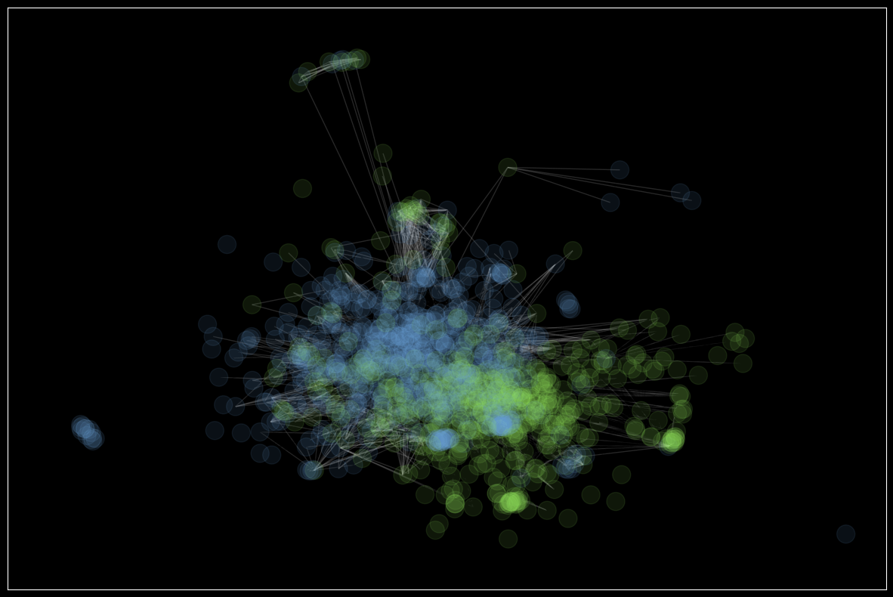
Books Networks: Community Detection Do the communities in the graph represent different genres of books?
Community detection using greedy modularity
Books separated by different genres
Thriller vs Romance

Slide 6
Books Networks: Conclusion
Based on conductance measurement:
Fiction genre is the most discernible genre, meaning that it is less likely to overlap with other genres
Pagerank, closeness centrality, degree centrality and betweenness centrality were used to find the most important nodes
The most important node on the graph:
The Girl Who Played with Fire (Millennium, #2) – 2009

Slide 7
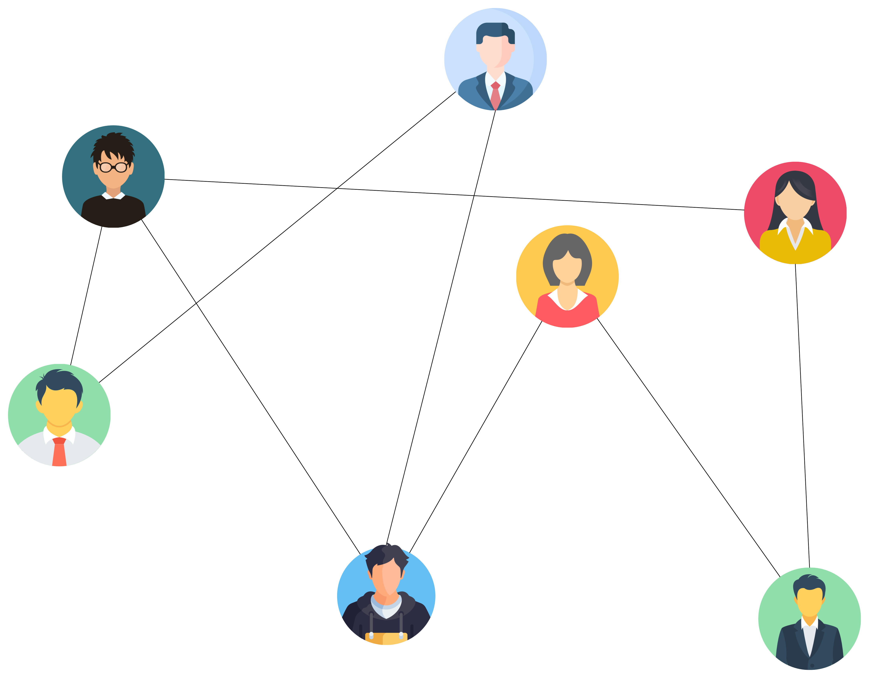






Users Network

Slide 8
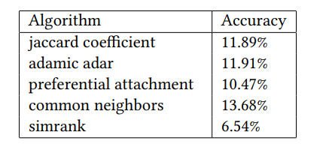
Link Prediction
Nov 2017
2007
2008
2009
2010
2011
2012
2013
2014
2015
2016
2017

Slide 9
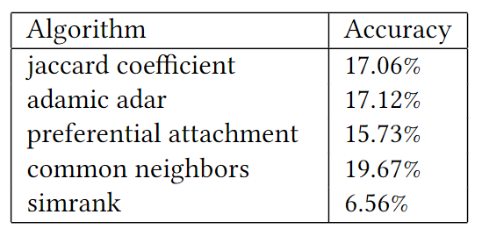
Link Prediction
Nov 2017
2007
2008
2009
2010
2011
2012
2013
2014
2015
2016
2017

Slide 10





Recommendation System
Jan 2007- Nov 2016
Jan 2007- Nov 2017
Edge | Jaccard Coeffiecient | Preferential attachment | cn_soundarajan | Adamic Adar | Shortest Path | Simrank | Label
 | 0.228045 | 483 | 1211744 | 71.059700 | 2 | 0.003263 | 1
 | 0.142929 | 285 | 569998 | 41.315670 | 2 | 0.003367 | 1
 | 0.003367 | 4 | 8148 | 0.336855 | 3 | 0.003486 | 0
 | 0.080688 | 61 | 136770 | 8.650781 | 2 | 0.003639 | 0
Edge | Label
 | 1
 | 1
 | 0
 | 0
Real Dataset Dimensions: 312086 rows × 8 columns

Slide 11
Recommendation System: Evaluation
We trained a Gradient Boosting Classifier model on the dataset.
Precision
Recall
F1 Score
71.08
%
74.12
%
72.57
%
Specificity
Sensitivity
Fallout
Accuracy
74.12
%
69.84
%
25.87
%
71.98
%

Slide 12
Trend Visualizations
Genres:
https://observablehq.com/d/6c2122f0341d1212
Books:
https://observablehq.com/d/9e49b9059f62929b

Slide 13

Thank You!
Contributors:
Hamed Taherkhani
hamedth@yorku.ca
Reza Abbaszadeh Darban
rezaab@yorku.ca
Mahdiye Khalajiolyaie
mahdiye7@yorku.ca
Abdullah Tauqeer
abdullatauqir@gmail.com

